Slide 1
10-423/10-623 GENERATIVE AI
Fine-Tuning vs. Retrieval for Small
LLMs
Aaron Tan
Amine Bouayad
Marius Nwobi

Slide 2
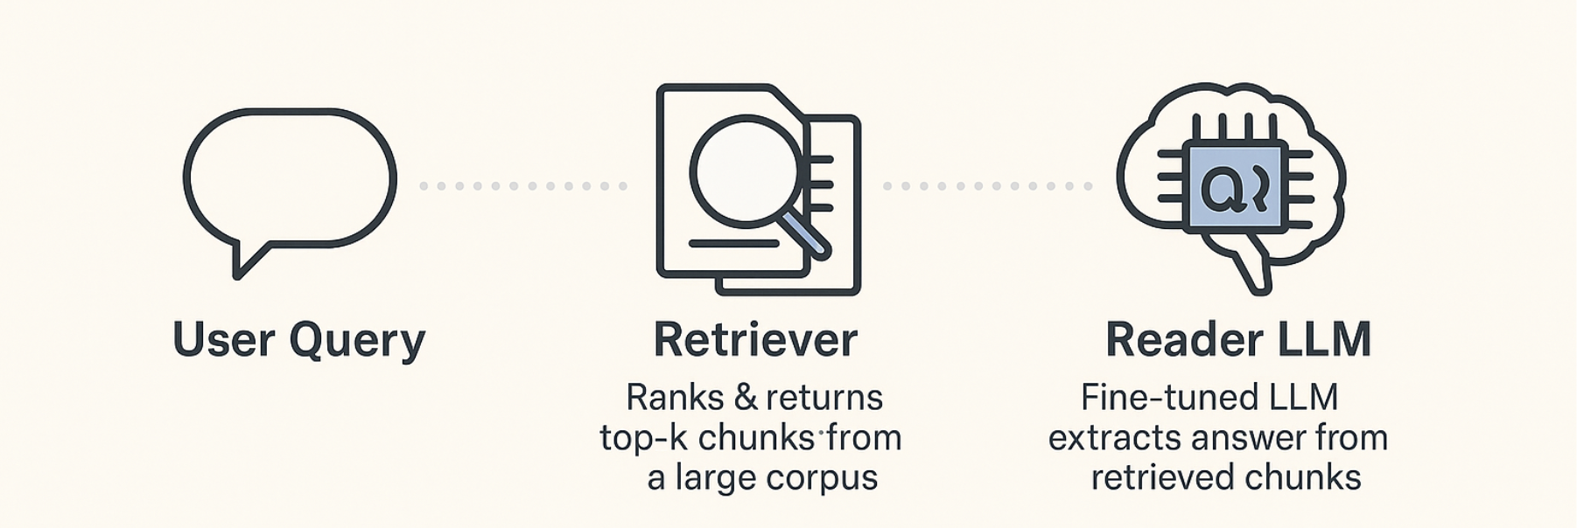
10-423/10-623 GENERATIVE AI
Retriever: the component that ranks and returns the most relevant chunks from a large Corpus.
Reader: the fine-tuned LLM that processes those chunks to extract answer
lightweight retrieval or parameter-efficient fine-tuning, which one yields the greater marginal accuracy gain per dollar ?

Slide 3
BM25 vs DPR
BM25 (“smart TF-IDF”) | DPR (Dense Passage Retrieval)
How it works • Counts query words in each doc. • Boosts rare words, trims gains after a few repeats. • Normalises for doc length. | How it works • Encodes queries and passages into dense vectors with a bi-encoder. • Uses dot-product similarity to pick top-k passages.
Signal type Lexical – exact word overlap. | Semantic – captures synonyms and paraphrases.
Training need None (formula-based). | Needs labeled Q&A pairs for contrastive training.
Speed / cost • Tiny index (BM25 scores from term lists). • CPU-friendly, no GPUs. | • Larger FAISS/ScaNN vector index. • GPU once for embedding; CPU at query time.
When it shines • Small or noisy corpora. • Queries with rare, specific terms. | • Open-domain QA, long-form search. • “Fast answer” chatbots needing semantic matches.
Limitations Misses synonyms (“car” ≠ “automobile”). | Needs upkeep: re-train or refresh embeddings as corpus grows.

Slide 4
Bert for questions answering
Head | What it predicts
Start-token classifier | probability each token is first word of the answer
End-token classifier | probability each token is last word of the answer

Slide 5
BM25 vs HNSW
BM25 (“smart TF-IDF”) | HNSW (Hierarchical Navigable Small Worlds)
How it works • Counts query words in each doc. • Boosts rare words, trims gains after a few repeats. • Normalises for doc length. | How it works Multiple layers of NSW (Navigable Small World) graphs Top layers: Few nodes with long-range connections (fast navigation) Bottom layers: All nodes with short-range connections (precision) Inspired by probabilistic skip lists, not traditional linked lists • Uses Cosine similarity to pick top-k passages after embedding with BERT.
Signal type Lexical – exact word overlap. | Semantic – captures synonyms and paraphrases.
Training need None (formula-based). | Needs document/context and ID.
Speed / cost • Tiny index (BM25 scores from term lists). • CPU-friendly, no GPUs. | • Fast since O(logN) for search of queries • Memory intensive • CPU
When it shines • Small or noisy corpora. • Queries with rare, specific terms. | • Can easily add new vectors to existing network. • Fast context retrieval • Lower latency
Limitations Misses synonyms (“car” ≠ “automobile”). | Limitations Needs a ton of memory Need to change ids or adjust params as you add more data

Slide 6
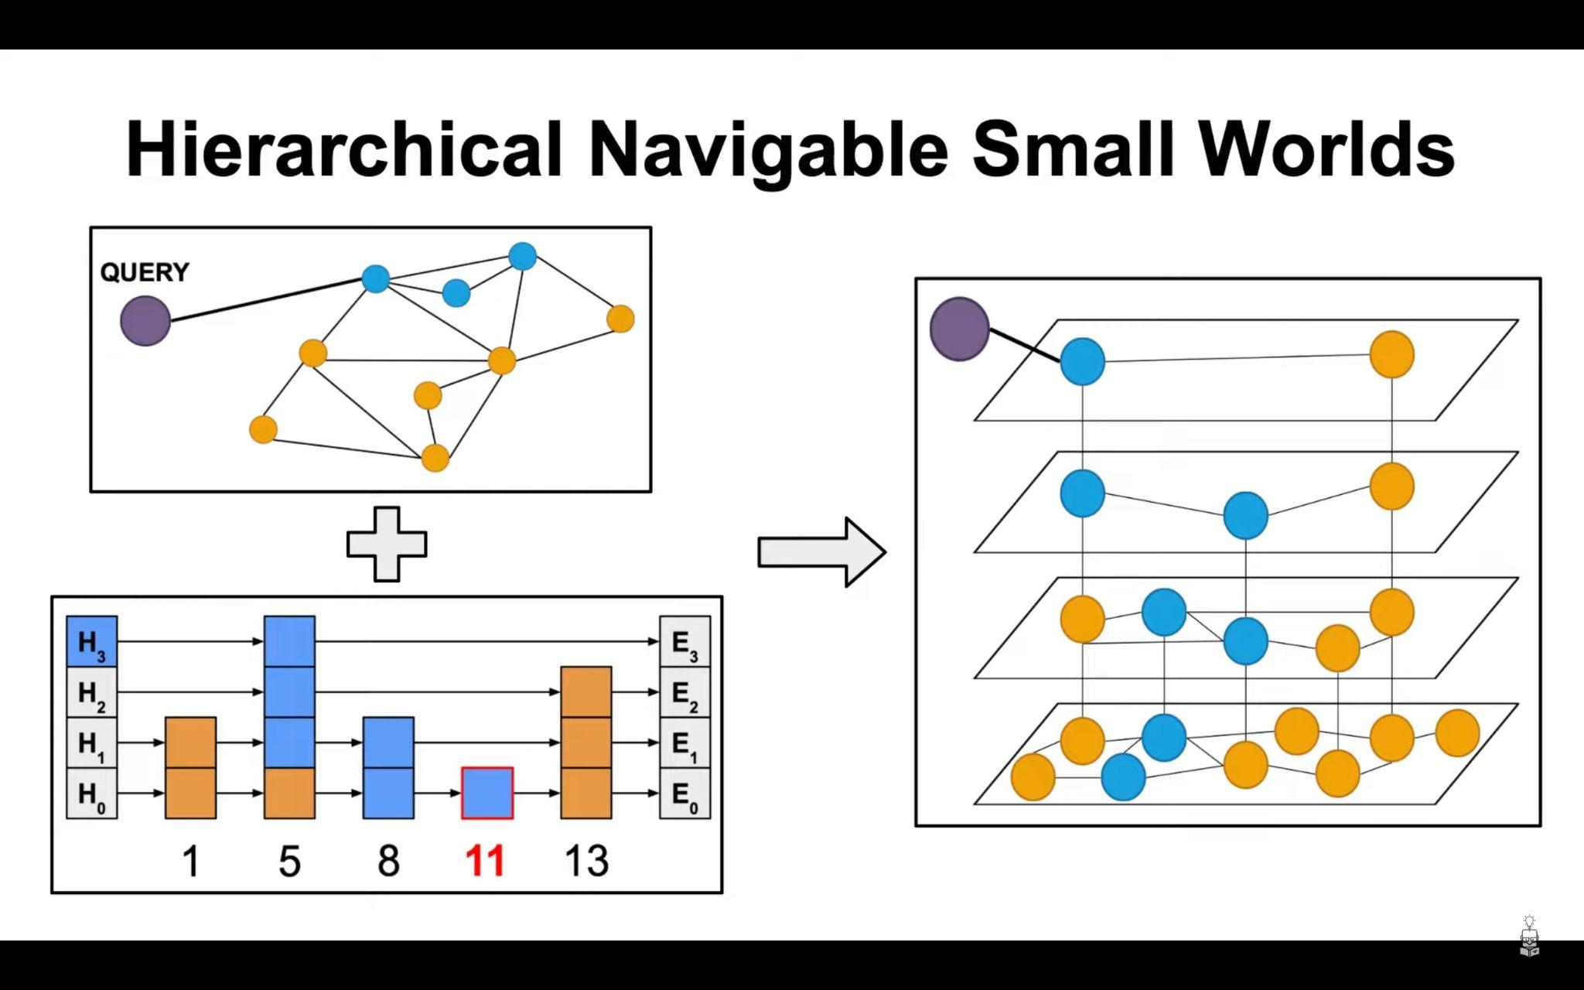
How HNSW works

Slide 7
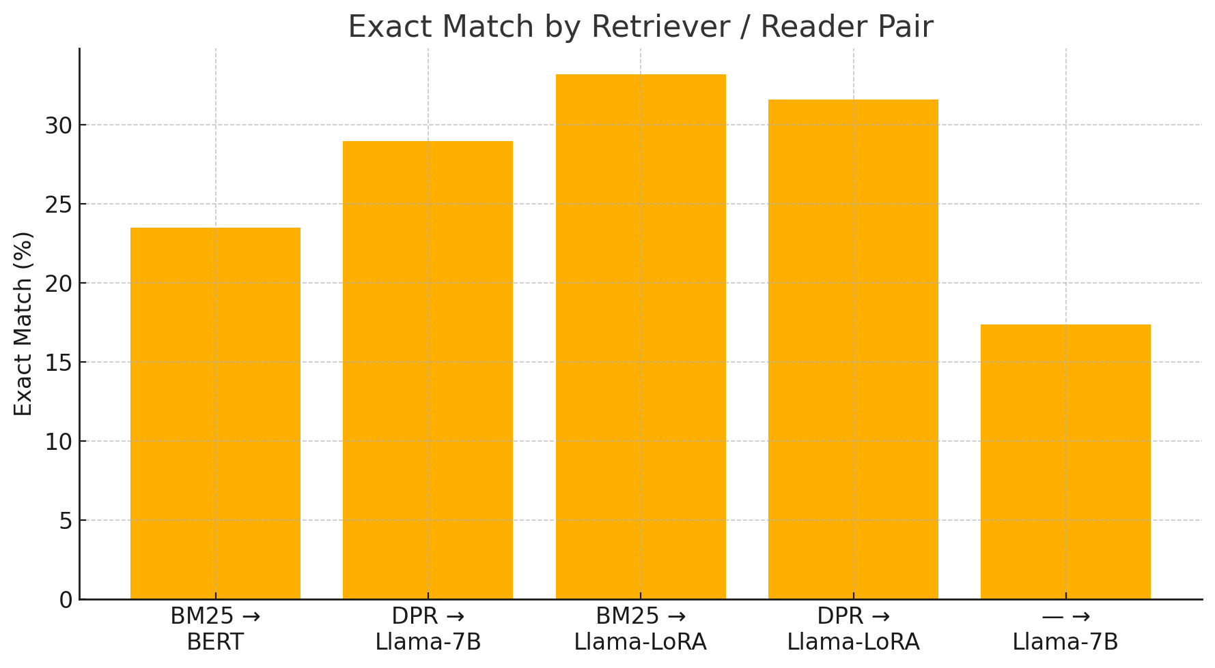
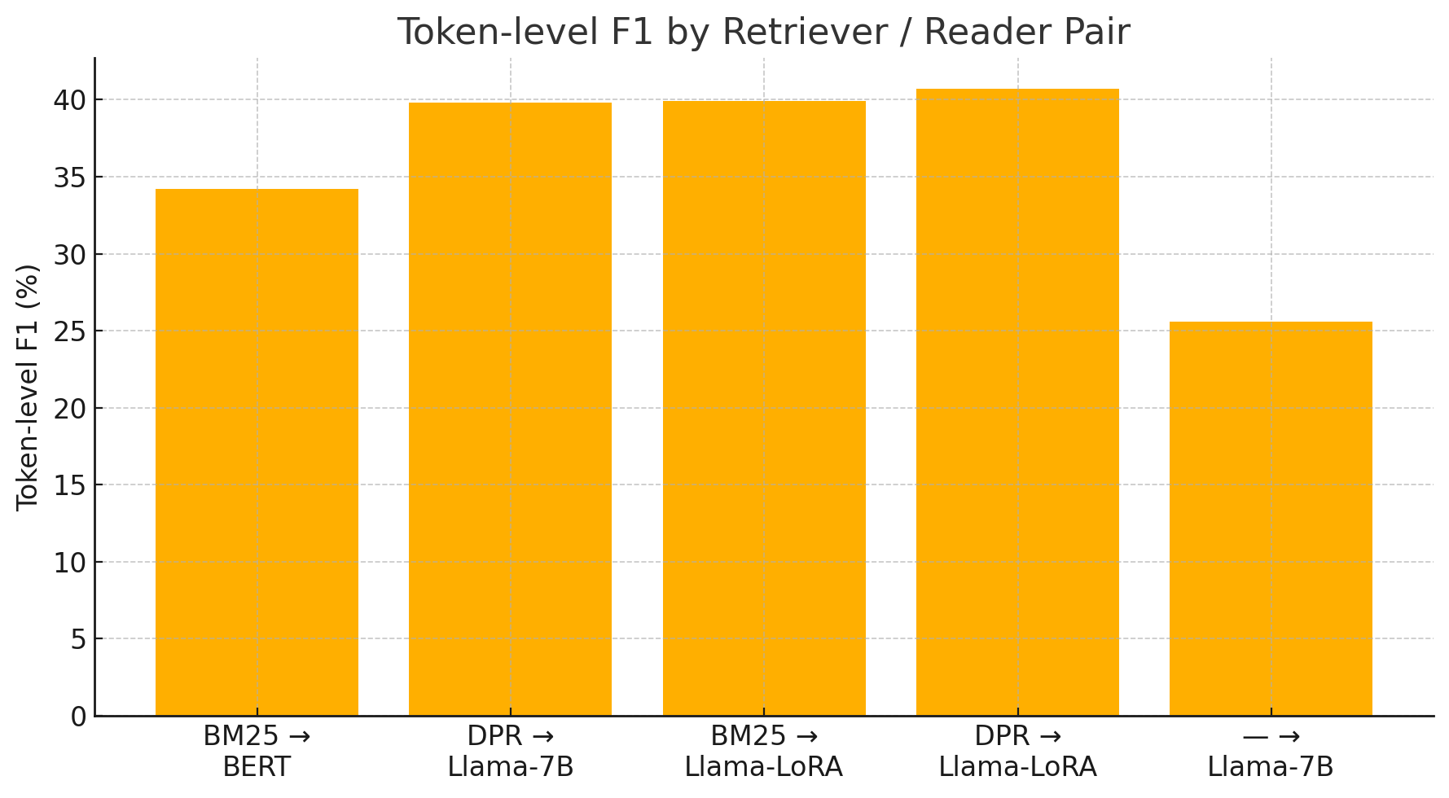
Experiments results
Exact Match performance
Token level F1

Slide 8
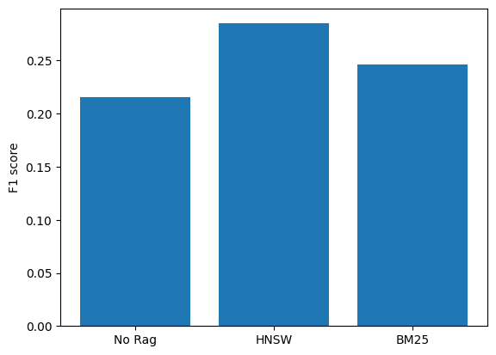
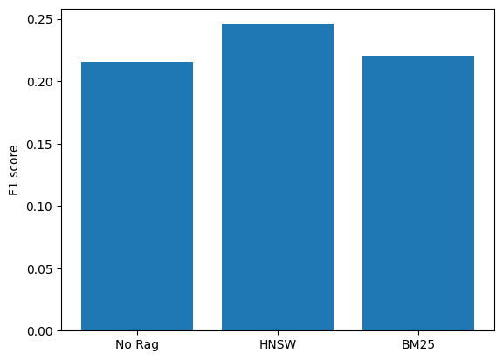
Experiments results
Average cosine score of about .37
Average Relevance score of 31.3
Llama 4 17B 16E is still running currently
Llama 3 8B

Slide 9
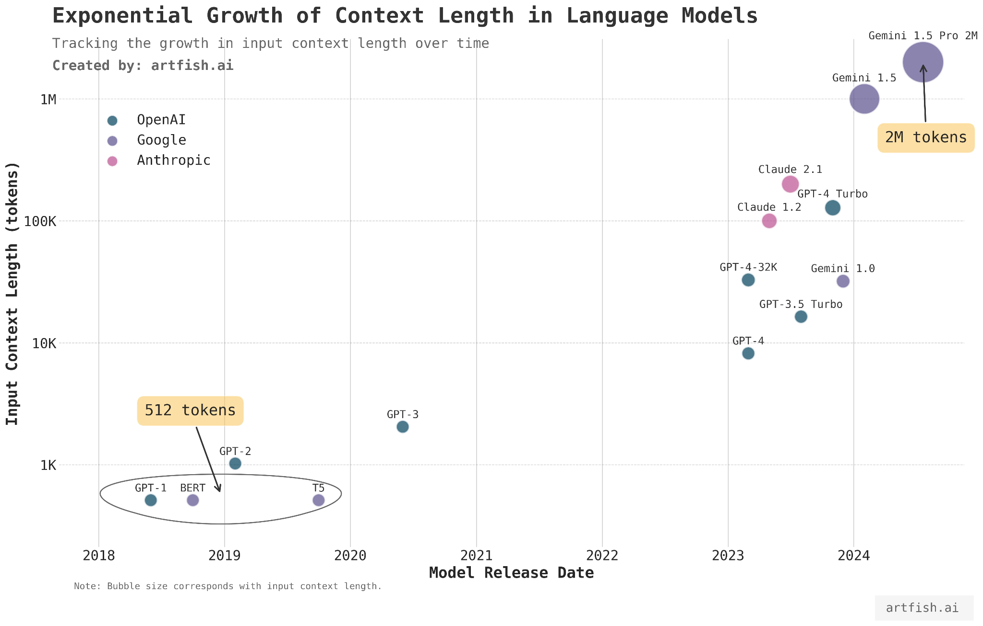
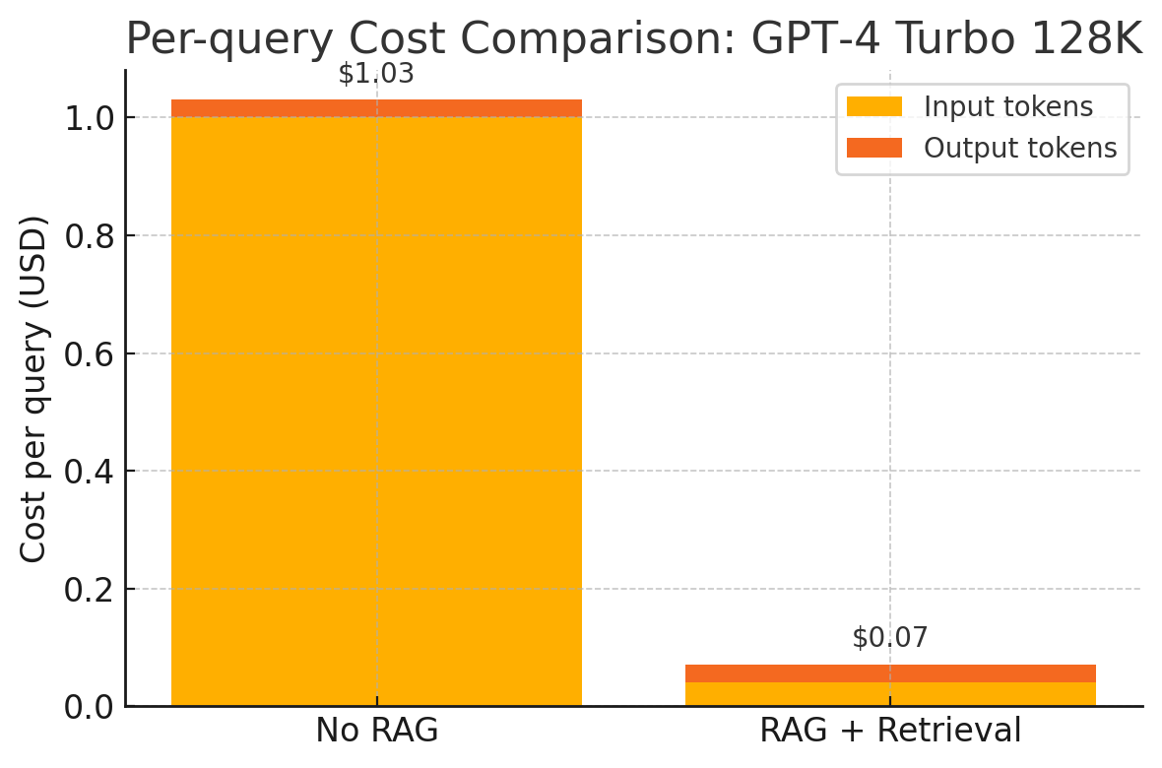
Is Rag still useful ?
Context length growth
Rag vs No rag

